Slide 1
Lecture - Objectives
Mapping Associative Entities
Mapping Unary Relationships
Mapping Ternary (and n-ary) Relationships
Mapping Supertype/Subtype Relationships

Slide 2
Transforming EER Diagrams into Relations (cont.)
Mapping Associative Entities
  Identifier Not Assigned
    Default primary key for the association relation is composed of the primary keys of the two entities (as in M:N relationship)
  Identifier Assigned
    It is natural and familiar to end-users
    Default identifier may not be unique

Slide 3
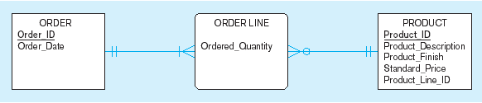
Figure 5-15 Example of mapping an associative entity
a) An associative entity

Slide 4
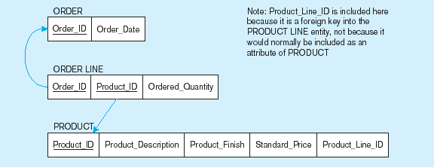
Figure 5-15 Example of mapping an associative entity (cont.)
b) Three resulting relations
Composite primary key formed from the two foreign keys

Slide 5

Figure 5-16 Example of mapping an associative entity with
an identifier
a) SHIPMENT associative entity

Slide 6
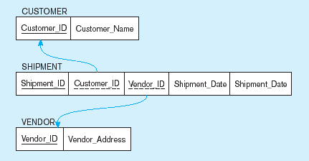
Figure 5-16 Example of mapping an associative entity with
an identifier (cont.)
b) Three resulting relations
Primary key differs from foreign keys

Slide 7
Transforming EER Diagrams into Relations (cont.)
Mapping Unary Relationships
  One-to-Many–Recursive foreign key in the same relation
  Many-to-Many– Make two relations:
    One for the entity type
    One for an associative relation in which the primary key has two attributes, both taken from the primary key of the entity

Slide 8
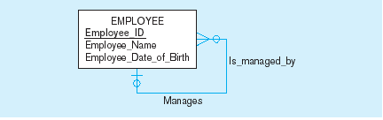

Figure 5-17 Mapping a unary 1:N relationship
(a) EMPLOYEE entity with unary relationship
(b) EMPLOYEE relation with recursive foreign key

Slide 9
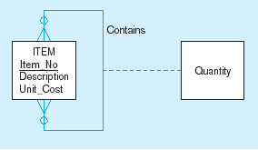
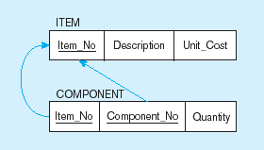
Figure 5-18 Mapping a unary M:N relationship
(a) Bill-of-materials relationships (M:N)
(b) ITEM and COMPONENT relations

Slide 10
Transforming EER Diagrams into Relations (cont.)
Mapping Ternary (and n-ary) Relationships
  One relation for each entity and one for the associative entity
  Associative entity has foreign keys to each entity in the relationship

Slide 11
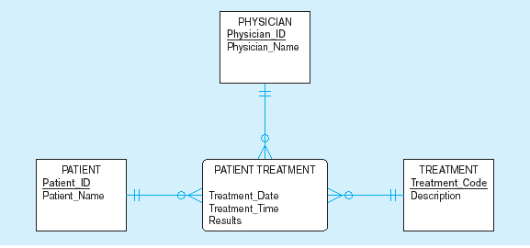
Figure 5-19 Mapping a ternary relationship
a) PATIENT TREATMENT Ternary relationship with associative entity

Slide 12
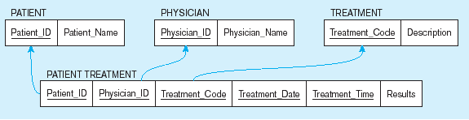
Figure 5-19 Mapping a ternary relationship (cont.)
b) Mapping the ternary relationship PATIENT TREATMENT
Remember that the primary key MUST be unique
This is why treatment date and time are included in the composite primary key
But this makes a very cumbersome key…
It would be better to create a surrogate key like Treatment#

Slide 13
Transforming EER Diagrams into Relations (cont.)
Mapping Supertype/Subtype Relationships
  One relation for supertype and for each subtype
  Supertype attributes (including identifier and subtype discriminator) go into supertype relation
  Subtype attributes go into each subtype; primary key of supertype relation also becomes primary key of subtype relation
  1:1 relationship established between supertype and each subtype, with supertype as primary table

Slide 14
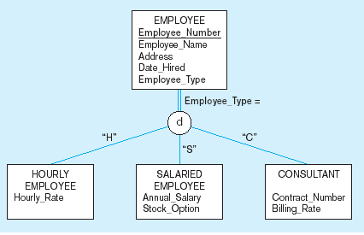
Figure 5-20 Supertype/subtype relationships

Slide 15
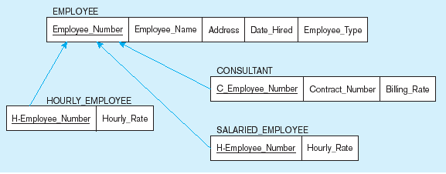
Figure 5-21
Mapping Supertype/subtype relationships to relations
These are implemented as one-to-one relationships

Slide 16
Thanks

